Slide 1
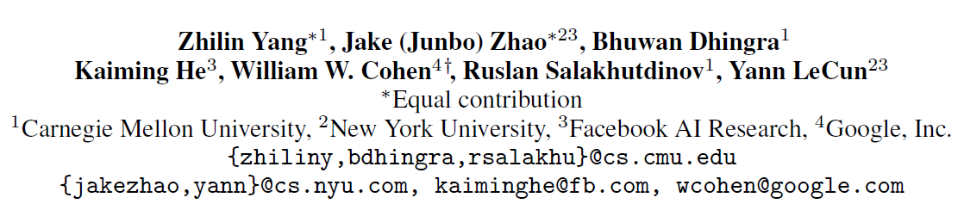
GLoMo: Unsupervisedly Learned Relational Graphs as Transferable Representations
NIPS 2018
Copyright © Shenglei Huang 2018.12.26

Slide 2
Traditional Transfer Learning

Slide 3
Traditional Transfer Learning
Examples:
Word embeddings pre-trained on large corpus;
CNN pre-trained on ImageNet

Slide 4
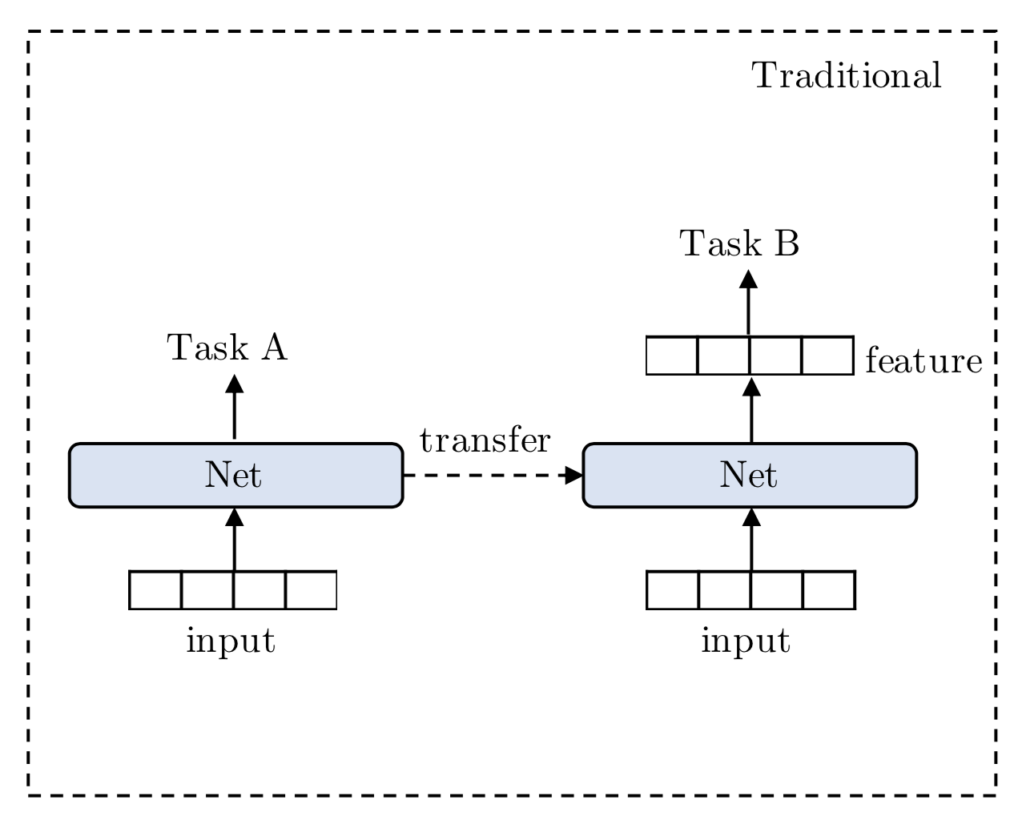
Traditional Transfer Learning
Examples:
Word embeddings pre-trained on large corpus;
CNN pre-trained on ImageNet
(Source data: Large)
(Target data: Small)

Slide 5
Traditional Transfer Learning
Examples:
Word embeddings pre-trained on large corpus;
CNN pre-trained on ImageNet
Quiz 1: In most NLP tasks, what does these features represent?
Semantic meaning
Syntactic structure
(Source data: Large)
(Target data: Small)

Slide 6
Traditional Transfer Learning
Examples:
Word embeddings pre-trained on large corpus;
CNN pre-trained on ImageNet
Semantic representation
Quiz 1: In most NLP tasks, what does these features represent? ☺
Semantic meaning
Syntactic structure
(Source data: Large)
(Target data: Small)

Slide 7
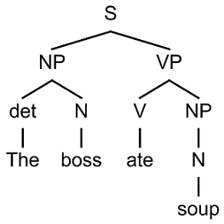
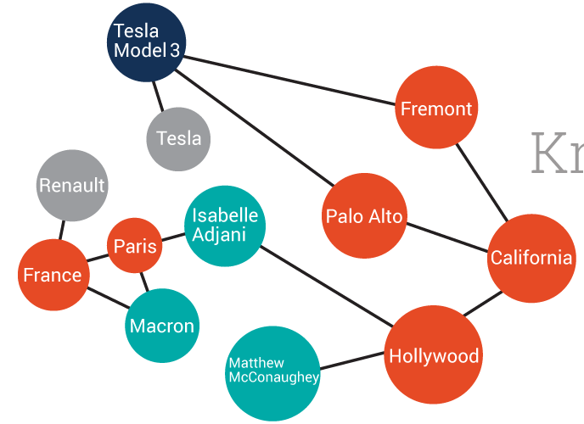
Structures in data
…Gary Bauer announced he would form an exploratory committee to run for president…
Parsing Tree
Knowledge Graph
Coreference Resolution

Slide 8
Structures in data
…Gary Bauer announced he would form an exploratory committee to run for president…
Parsing Tree
Knowledge Graph
Coreference Resolution
Versatile structure

Slide 9
Motivation
Current transfer learning model only captures semantic meaning;
A variety of real-world data exhibit much richer structures than sequential structure;
Goal
To transfer a structure in addition to semantic meaning;
To learn versatile structures of data with data-driven approach instead of human-curated structures.

Slide 10
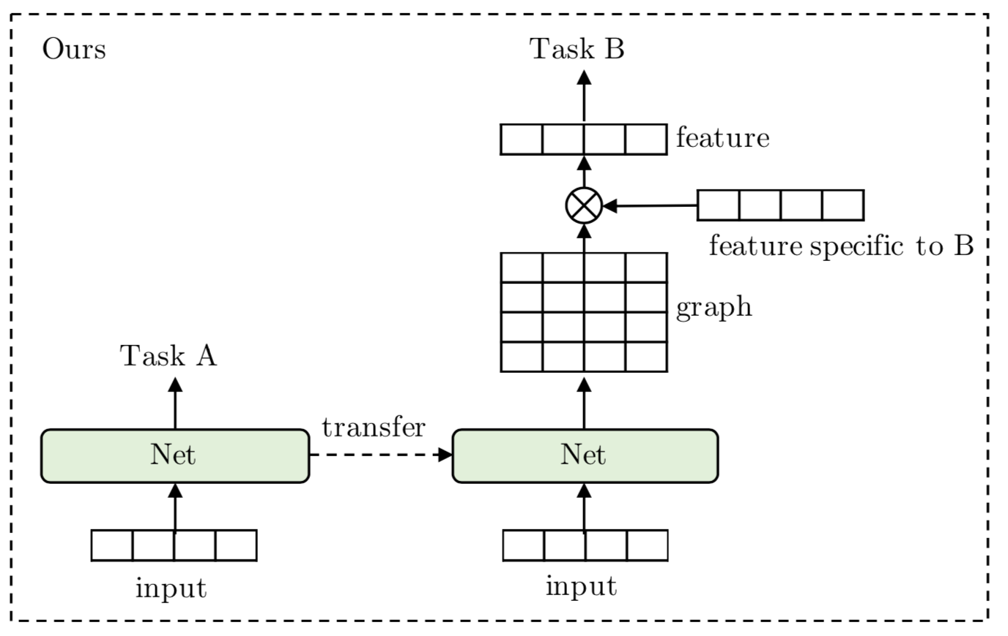
Overall Transfer Learning Model
Semantic representation
Structural representation

Slide 11
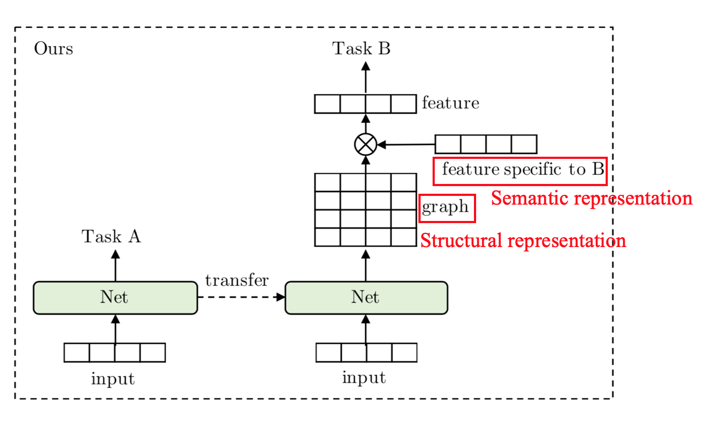
Overall Transfer Learning Model
Semantic representation

Slide 12
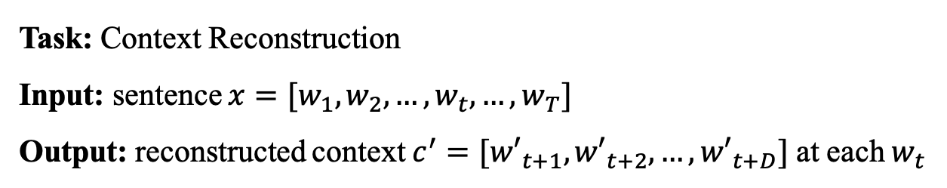
Pre-trained Model: To learn versatile structure
Task: Context Reconstruction
Input: sentence $x=[w_{1},w_{2},…,w_{t},…,w_{T}]$
Output: reconstructed context $c^{′}=[{w′}_{t+1},{w′}_{t+2},…,{w′}_{t+D}]$ at each $w_{t}$

Slide 13


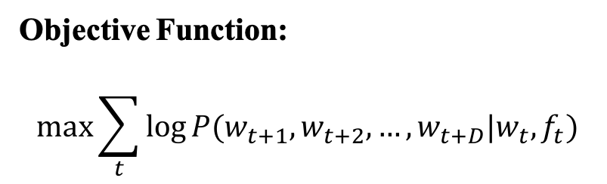
Pre-trained Model: To learn versatile structure
Task: Context Reconstruction
Input: sentence $x=[w_{1},w_{2},…,w_{t},…,w_{T}]$
Output: reconstructed context $c^{′}=[{w′}_{t+1},{w′}_{t+2},…,{w′}_{t+D}]$ at each $w_{t}$
$$w_{1},w_{2},…,w_{t},…,w_{T}$$
Objective Function:
$$\max{\sum_{t}{\log{P(w_{t+1}, w_{t+2},…,w_{t+D}|w_{t}, f_{t})}}}$$
GLoMo
$$f_{1},f_{2},…,f_{t},…,f_{T}$$

Slide 14
Pre-trained Model: Task definition
Task: Context Reconstruction
Input: sentence $x=[w_{1},w_{2},…,w_{t},…,w_{T}]$
Output: reconstructed context $c^{′}=[{w′}_{t+1},{w′}_{t+2},…,{w′}_{t+D}]$ at each $w_{t}$
$$w_{1},w_{2},…,w_{t},…,w_{T}$$
Objective Function:
$$\max{\sum_{t}{\log{P(w_{t+1}, w_{t+2},…,w_{t+D}|w_{t}, f_{t})}}}$$
GLoMo
$$f_{1},f_{2},…,f_{t},…,f_{T}$$
Semantic features combined with structure features

Slide 15
Pre-trained Model: To learn versatile structure
Goal:
To learn versatile structure
To combine semantic features with these structure features

Slide 16
Pre-trained Model: To learn versatile structure
Goal:
To learn versatile structure
To combine semantic features with these structure features

Slide 17











Pre-trained Model: To learn versatile structure
Goal:
To learn versatile structure
To combine semantic features with these structure features
Structure Definition: asymmetric affinity matrix (directed weighted graph)
$$w_{1}$$
$$w_{2}$$
$$w_{3}$$
$$w_{4}$$
$$w_{5}$$
0 | 0 | 0 | 0 | 0
1 | 0 | 0 | 0 | 0
0 | 1 | 0 | 0 | 0
1 | 0 | 0 | 0 | 0
0 | 0 | 0 | 1 | 0
$$w_{5}$$
$$w_{1}$$
$$w_{2}$$
$$w_{3}$$
$$w_{4}$$
$$w_{5}$$
$$w_{4}$$
$$w_{1}$$
$$w_{2}$$
$$w_{3}$$

Slide 18
Pre-trained Model: To learn versatile structure
Goal:
To learn versatile structure
To combine semantic features with these structure features
Structure Definition: asymmetric affinity matrix (directed weighted graph)
$$w_{1}$$
$$w_{2}$$
$$w_{3}$$
$$w_{4}$$
$$w_{5}$$
0 | 0 | 0 | 0 | 0
1 | 0 | 0 | 0 | 0
0 | 1 | 0 | 0 | 0
1 | 0 | 0 | 0 | 0
0 | 0 | 0 | 1 | 0
$$w_{5}$$
Affinity matrix between each input word
$$w_{1}$$
$$w_{2}$$
$$w_{3}$$
$$w_{4}$$
$$w_{5}$$
$$w_{4}$$
$$w_{1}$$
$$w_{2}$$
$$w_{3}$$

Slide 19






Pre-trained Model: To learn versatile structure
Goal:
To learn versatile structure
To combine semantic features with these structure features
Graph Predictor 1
$$G_{∙1}^{1},…,G_{∙T}^{1}$$
Key CNN
$$k_{1},…,k_{T}$$
Graph Predictor 2
$$G_{∙1}^{2},…,G_{∙T}^{2}$$
$$w_{1},…,w_{T}$$
Query CNN
$$q_{1},…,q_{T}$$
…
Graph Predictor L
$$G_{∙1}^{L},…,G_{∙T}^{L}$$

Slide 20
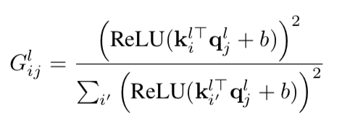






Pre-trained Model: To learn versatile structure
Goal:
To learn versatile structure
To combine semantic features with these structure features
Graph Predictor 1
$$G_{∙1}^{1},…,G_{∙T}^{1}$$
$$k_{1},…,k_{T}$$
Graph Predictor 2
$$G_{∙1}^{2},…,G_{∙T}^{2}$$
$$q_{1},…,q_{T}$$
…
Graph Predictor L
$$G_{∙1}^{L},…,G_{∙T}^{L}$$

Slide 21



Pre-trained Model: To learn versatile structure
Goal:
To learn versatile structure
To combine semantic features with these structure features
$$w_{1},…,w_{T}$$
Graph Predictor 1
$$G_{∙1}^{1},…,G_{∙T}^{1}$$
Feature extractor 1
$$f_{1}^{1},…,f_{T}^{1}$$
$$k_{1},…,k_{T}$$
Graph Predictor 2
$$G_{∙1}^{2},…,G_{∙T}^{2}$$
Feature extractor 2
$$q_{1},…,q_{T}$$
…
…
Graph Predictor L
$$G_{∙1}^{L},…,G_{∙T}^{L}$$
Feature extractor 2
$$f_{1}^{L},…,f_{T}^{L}$$

Slide 22
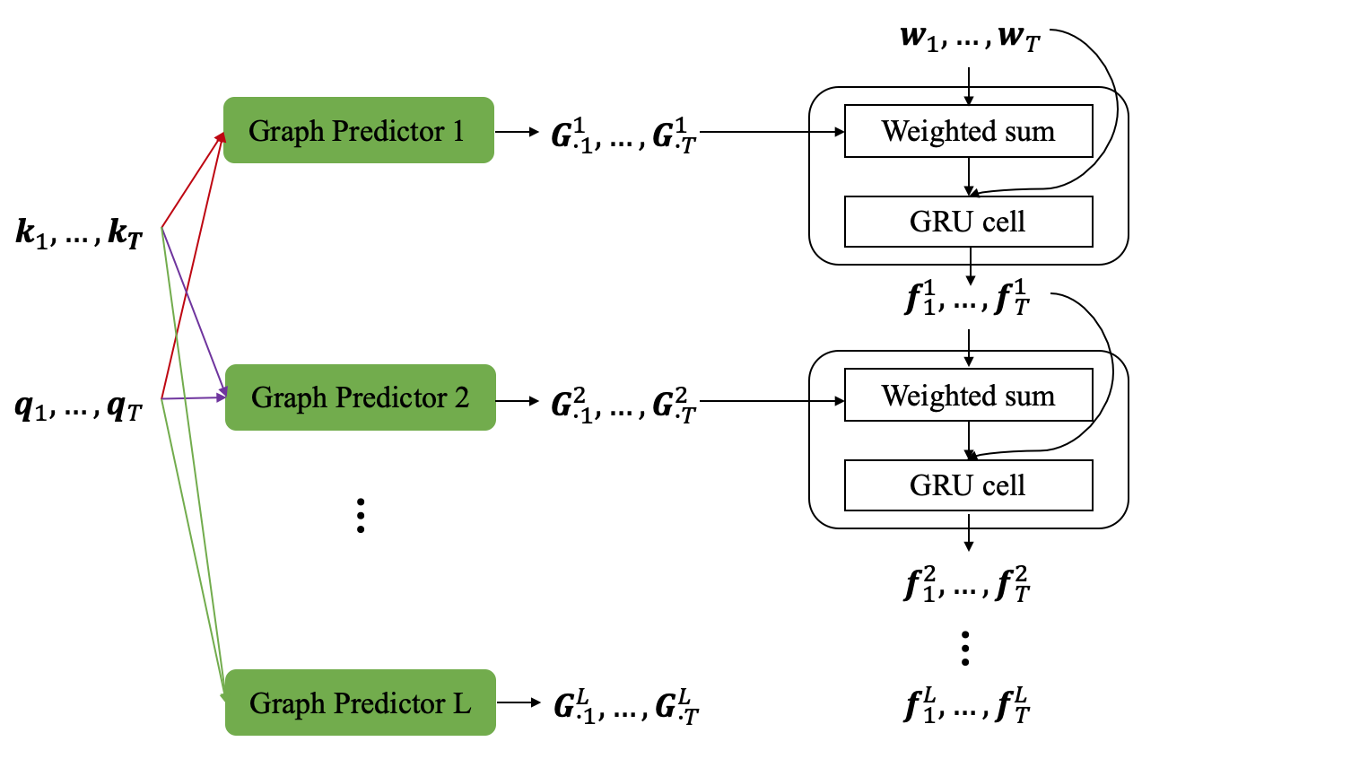
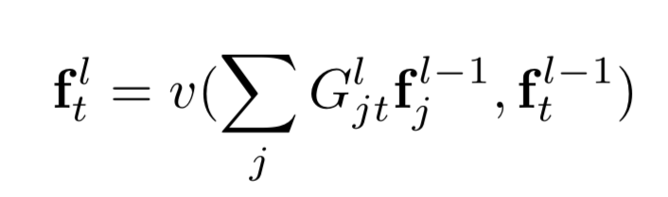
Pre-trained Model: To learn versatile structure
Goal:
To learn versatile structure
To combine semantic features with these structure features

Slide 23
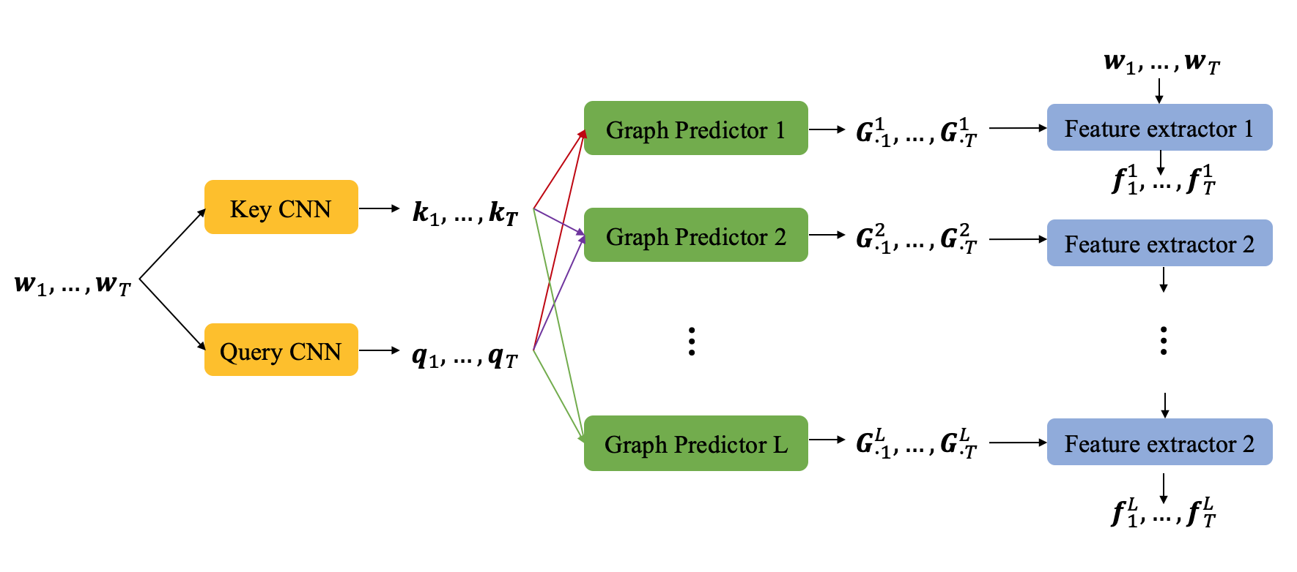
Pre-trained Model: To learn versatile structure
Goal:
To learn versatile structure
To combine semantic features with these structure features
To learn hierarchical structure
Semantic features combined with hierarchical structure features

Slide 24






Graph Predictor: vs. Self-Attention (1)
$$k_{1},…,k_{T}$$
$$k_{1},…,k_{T}$$
Graph Predictor $l$
Self-Attention
$$A$$
$$G^{l}$$
$$q_{1},…,q_{T}$$
$$k_{1},…,k_{T}$$
$$A_{ij}=\frac{\exp{({k_{i}^{l}}^{T}k_{j}^{l})}}{\sum_{i^{′}}{(\exp{({k_{i^{′}}^{l}}^{T}k_{j}^{l})})}}$$
where $k_{i}^{l}=W_{k}^{l}k_{i}$

Slide 25



Graph Predictor: vs. Self-Attention (2)
$$w_{1},…,w_{T}$$
CNN
Graph Predictor
Feature extractor
$$f_{1}^{L},…,f_{T}^{L}$$
GLoMo:
Self-Attention:
$$w_{1},…,w_{T}$$
CNN
Feature extractor
Self-Attention
$$f_{1}^{L},…,f_{T}^{L}$$

Slide 26
Graph Predictor: vs. Self-Attention (2)
$$w_{1},…,w_{T}$$
CNN
Graph Predictor
Feature extractor
$$f_{1}^{L},…,f_{T}^{L}$$
GLoMo:
Self-Attention:
$$w_{1},…,w_{T}$$
CNN
Feature extractor
Self-Attention
$$f_{1}^{L},…,f_{T}^{L}$$
Quiz 2: What is the benefit of this design of graph predictor?
It decouples graph predictor from feature extractor, which is beneficial in transfer model.
It looks much fancy!

Slide 27
Graph Predictor vs. Self-Attention (2)
$$w_{1},…,w_{T}$$
CNN
Graph Predictor
Feature extractor
$$f_{1}^{L},…,f_{T}^{L}$$
GLoMo:
Self-Attention:
$$w_{1},…,w_{T}$$
CNN
Feature extractor
Self-Attention
$$f_{1}^{L},…,f_{T}^{L}$$
Quiz 2: What is the benefit of this design of graph predictor? ☺
It decouples graph predictor from feature extractor, which is beneficial in transfer model.
It looks much fancy!

Slide 28
Graph Predictor: Hierarchical structure

Slide 29
Graph Predictor: Hierarchical structure
Hierarchical structure

Slide 30

Graph Predictor: Hierarchical structure
$$w_{5}$$
$$w_{4}$$
1-hop relation
$$w_{1}$$
$$w_{2}$$
$$w_{3}$$
$$f_{1}^{1}=G_{2,1}^{1}×w_{2}+G_{4,1}^{1}×w_{4}$$
Hierarchical structure

Slide 31

Graph Predictor: Hierarchical structure
$$w_{5}$$
$$w_{4}$$
1-hop relation
$$w_{1}$$
$$w_{2}$$
$$w_{3}$$
$$f_{1}^{1}=G_{2,1}^{1}×w_{2}+G_{4,1}^{1}×w_{4}$$
$$f_{2}^{1}=G_{3,2}^{1}×w_{3}$$
Hierarchical structure

Slide 32

Graph Predictor: Hierarchical structure
$$w_{5}$$
$$w_{4}$$
1-hop relation
$$w_{1}$$
$$w_{2}$$
$$w_{3}$$
$$f_{1}^{1}=G_{2,1}^{1}×w_{2}+G_{4,1}^{1}×w_{4}$$
$$f_{2}^{1}=G_{3,2}^{1}×w_{3}$$
$$f_{4}^{1}=G_{5,4}^{1}×w_{5}$$
Hierarchical structure

Slide 33



Graph Predictor: Hierarchical structure
$$w_{5}$$
$$w_{4}$$
1-hop relation
$$w_{1}$$
$$w_{2}$$
$$w_{3}$$
2-hop relation
$$f_{1}^{1}=G_{2,1}^{1}×w_{2}+G_{4,1}^{1}×w_{4}$$
$$f_{1}^{1}=G_{2,1}^{1}×w_{2}+G_{4,1}^{1}×w_{4}$$
$$f_{2}^{1}=G_{3,2}^{1}×w_{3}$$
$$f_{2}^{1}=G_{3,2}^{1}×w_{3}$$
$$f_{4}^{1}=G_{5,4}^{1}×w_{5}$$
Hierarchical structure
$$f_{1}^{2}=G_{2,1}^{2}×f_{2}^{1}+G_{4,1}^{2}×f_{4}^{1}$$

Slide 34


Graph Predictor: Hierarchical structure
$$w_{5}$$
$$w_{4}$$
1-hop relation
$$w_{1}$$
$$w_{2}$$
$$w_{3}$$
2-hop relation
$$f_{1}^{1}=G_{2,1}^{1}×w_{2}+G_{4,1}^{1}×w_{4}$$
$$f_{1}^{1}=G_{2,1}^{1}×w_{2}+G_{4,1}^{1}×w_{4}$$
$$f_{2}^{1}=G_{3,2}^{1}×w_{3}$$
$$f_{2}^{1}=G_{3,2}^{1}×w_{3}$$
$$f_{4}^{1}=G_{5,4}^{1}×w_{5}$$
Hierarchical structure
$$f_{1}^{2}=G_{2,1}^{2}×f_{2}^{1}+G_{4,1}^{2}×f_{4}^{1}$$

Slide 35
Graph Predictor: Hierarchical structure
$$w_{5}$$
$$w_{4}$$
1-hop relation
$$w_{1}$$
$$w_{2}$$
$$w_{3}$$
2-hop relation
$$f_{1}^{1}=G_{2,1}^{1}×w_{2}+G_{4,1}^{1}×w_{4}$$
$$f_{1}^{1}=G_{2,1}^{1}×w_{2}+G_{4,1}^{1}×w_{4}$$
$$f_{2}^{1}=G_{3,2}^{1}×w_{3}$$
$$f_{2}^{1}=G_{3,2}^{1}×w_{3}$$
$$f_{4}^{1}=G_{5,4}^{1}×w_{5}$$
Hierarchical structure
$$f_{1}^{2}=G_{2,1}^{2}×f_{2}^{1}+G_{4,1}^{2}×f_{4}^{1}=G_{2,1}^{2}×G_{3,2}^{1}×w_{3}+G_{4,1}^{2}×G_{5,4}^{1}×w_{5}$$

Slide 36
Graph Predictor: Hierarchical structure
$$w_{5}$$
$$w_{4}$$
1-hop relation
$$w_{1}$$
$$w_{2}$$
$$w_{3}$$
2-hop relation
$$f_{1}^{1}=G_{2,1}^{1}×w_{2}+G_{4,1}^{1}×w_{4}$$
$$f_{1}^{1}=G_{2,1}^{1}×w_{2}+G_{4,1}^{1}×w_{4}$$
$$f_{2}^{1}=G_{3,2}^{1}×w_{3}$$
$$f_{2}^{1}=G_{3,2}^{1}×w_{3}$$
L-hop relation
$$f_{4}^{1}=G_{5,4}^{1}×w_{5}$$
Hierarchical structure
$$f_{1}^{2}=G_{2,1}^{2}×f_{2}^{1}+G_{4,1}^{2}×f_{4}^{1}=G_{2,1}^{2}×G_{3,2}^{1}×w_{3}+G_{4,1}^{2}×G_{5,4}^{1}×w_{5}$$
…

Slide 37
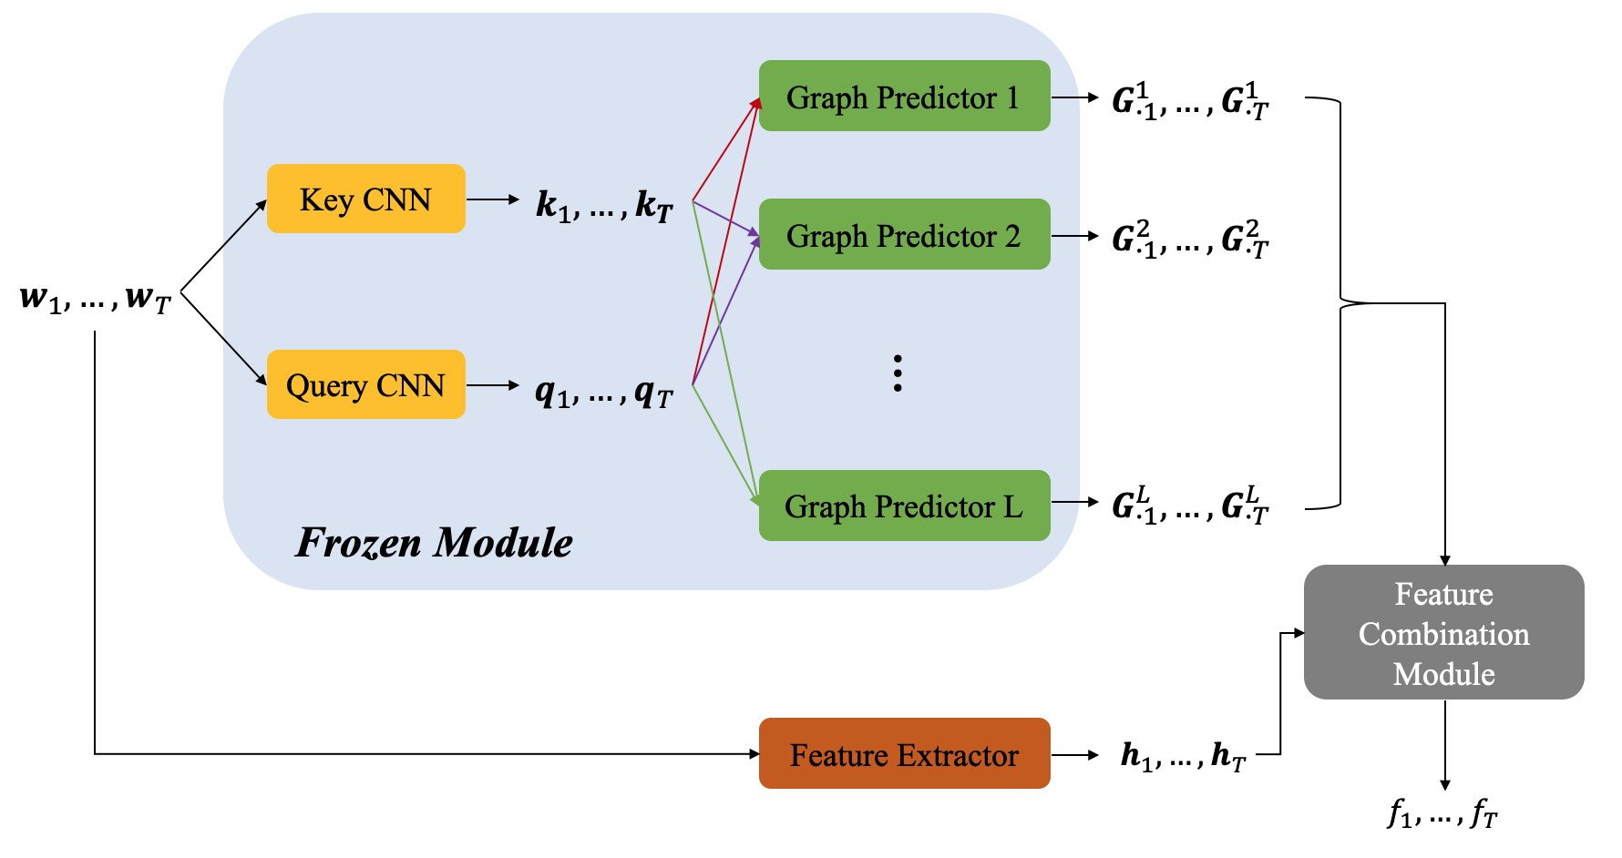
Transfer Model: Overall

Slide 38
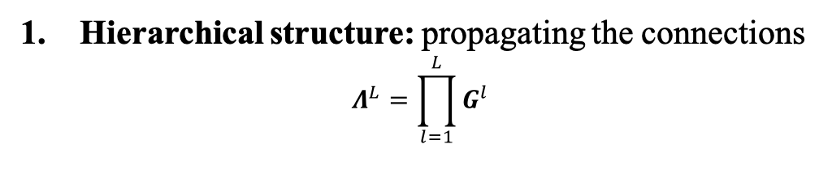
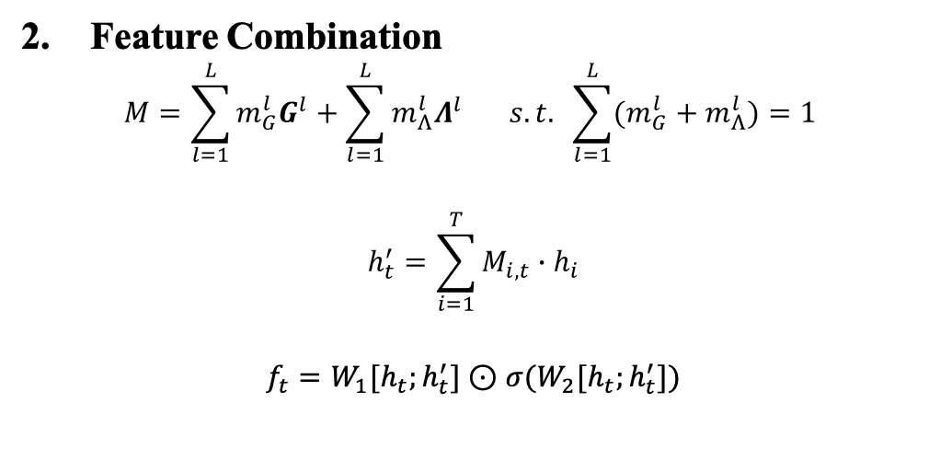
Transfer Model: Feature combination module
1. Hierarchical structure: propagating the connections
$$Λ^{L}=\prod_{l=1}^{L}{G^{l}}$$
Feature Combination
$$M=\sum_{l=1}^{L}{m_{G}^{l}G^{l}}+\sum_{l=1}^{L}{m_{Λ}^{l}Λ^{l}} s.t. \sum_{l=1}^{L}{(m_{G}^{l}+m_{Λ}^{l})}=1$$
$$h_{t}^{′}=\sum_{i=1}^{T}{M_{i,t}∙h_{i}}$$
$$f_{t}=W_{1}[h_{t};h_{t}^{′}]⊙σ(W_{2}[h_{t};h_{t}^{′}])$$

Slide 39
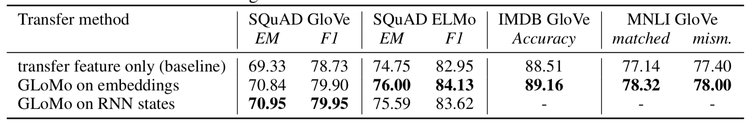
Experiments: On different NLP tasks
Question Answering
Sentiment Analysis
Natural Language Inference

Slide 40
Experiments: On different NLP tasks
Question Answering
Sentiment Analysis
Natural Language Inference

Slide 41
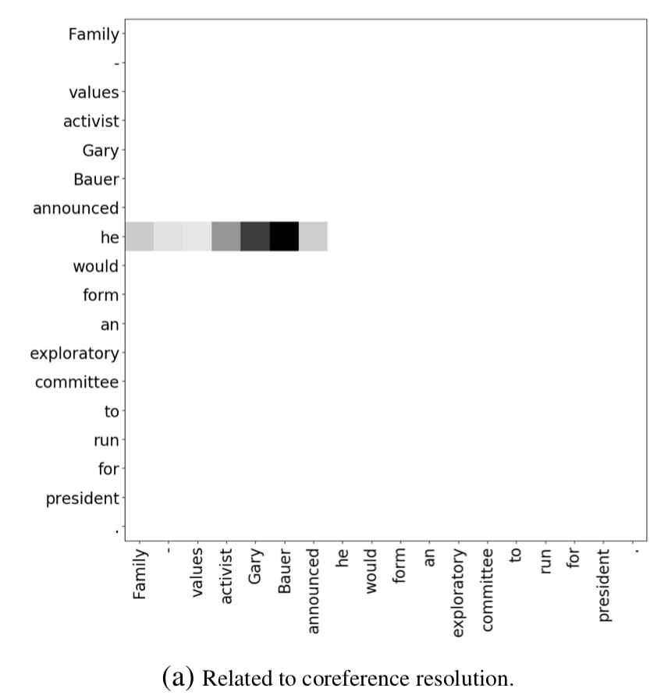
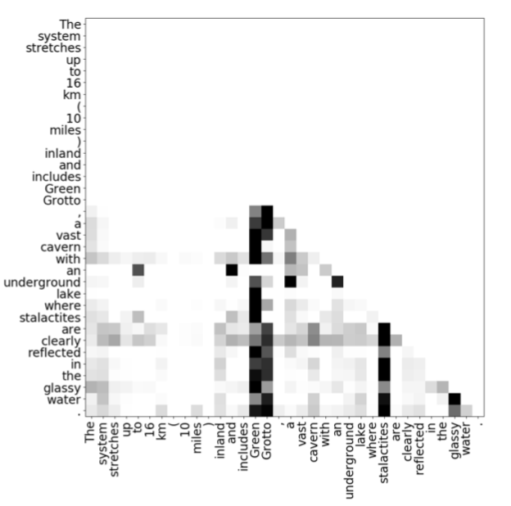
Experiments: Graph visualization (1)
a) Coreference resolution
b) Attending to objects for modeling long-term dependency

Slide 42
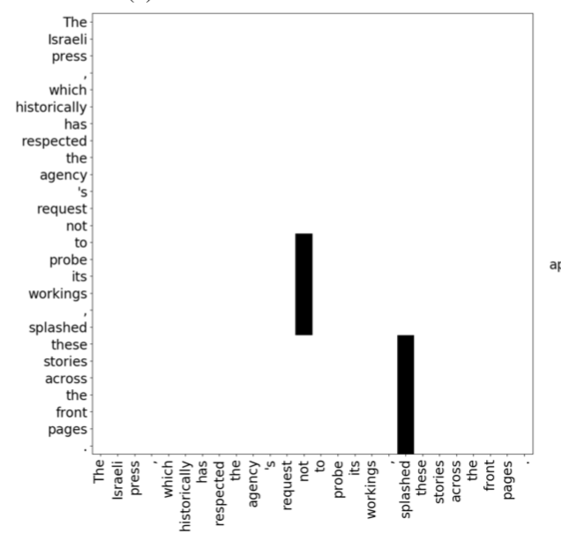
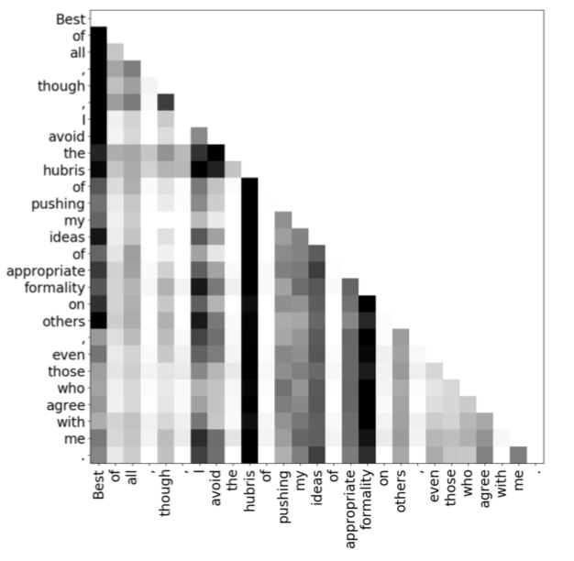
Experiments: Graph visualization (2)
c) Attending to negative words and predicates
d) Attending to nouns, verbs, and adjectives for topic modeling.
Notes:
the words following “not” attend to “not” so that they are aware of the negation;
the predicate “splashed” is attended by the following object and adverbial.
demonstrates a way of topic modeling by attending to informative words in the sentence.

Slide 43
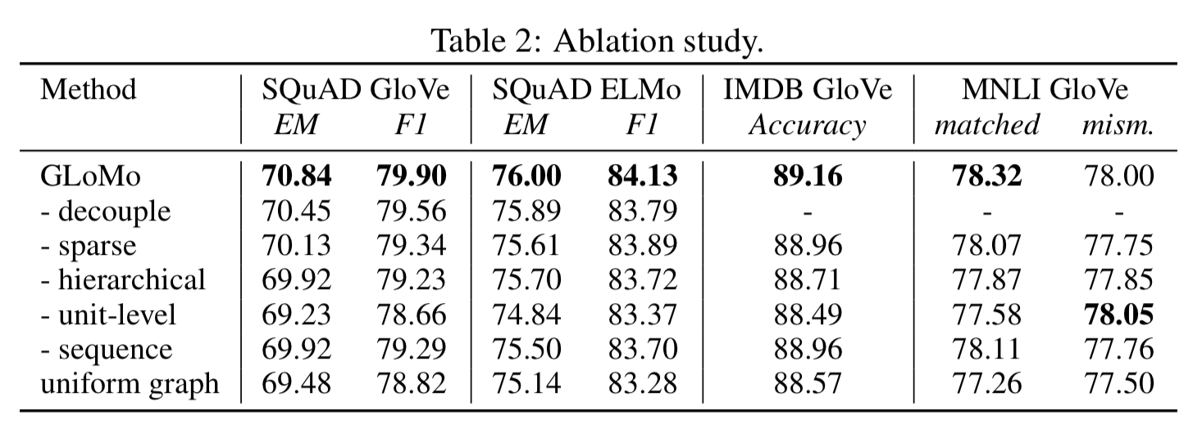
Experiments: Ablation study

Slide 44
Conclusions
Pros:
GLoMo could learn a versatile structure from large data with unsupervised approach;
Decoupling structure feature from sematic feature increases the transferability;
Cons:
GLoMo doesn’t support cross-domain

Slide 45
Thank you ☺

Slide 46









Figures
$$w_{1},…,w_{T}$$
Graph Predictor 1
$$G_{∙1}^{1},…,G_{∙T}^{1}$$
Weighted sum
$$k_{1},…,k_{T}$$
GRU cell
$$f_{1}^{1},…,f_{T}^{1}$$
$$q_{1},…,q_{T}$$
Graph Predictor 2
$$G_{∙1}^{2},…,G_{∙T}^{2}$$
Weighted sum
…
GRU cell
$$f_{1}^{2},…,f_{T}^{2}$$
…
Graph Predictor L
$$G_{∙1}^{L},…,G_{∙T}^{L}$$
$$f_{1}^{L},…,f_{T}^{L}$$

Slide 47








$$w_{1},…,w_{T}$$
Graph Predictor 1
$$G_{∙1}^{1},…,G_{∙T}^{1}$$
Feature extractor 1
$$f_{1}^{1},…,f_{T}^{1}$$
Key CNN
$$k_{1},…,k_{T}$$
Graph Predictor 2
$$G_{∙1}^{2},…,G_{∙T}^{2}$$
Feature extractor 2
$$w_{1},…,w_{T}$$
Query CNN
$$q_{1},…,q_{T}$$
…
…
Graph Predictor L
$$G_{∙1}^{L},…,G_{∙T}^{L}$$
Feature extractor 2
$$f_{1}^{L},…,f_{T}^{L}$$

Slide 48


Graph Predictor 1
$$G_{∙1}^{1},…,G_{∙T}^{1}$$
Key CNN
$$k_{1},…,k_{T}$$
Graph Predictor 2
$$G_{∙1}^{2},…,G_{∙T}^{2}$$
$$w_{1},…,w_{T}$$
Query CNN
$$q_{1},…,q_{T}$$
…
Graph Predictor L
$$G_{∙1}^{L},…,G_{∙T}^{L}$$
Frozen Module
Feature Combination Module
Feature Extractor
$$h_{1},…,h_{T}$$
$$f_{1},…,f_{T}$$

